Slide 1
Information Security
presentation

Slide 2
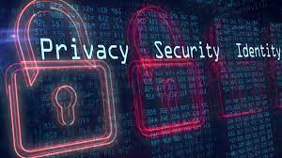
Role of Information Security
In today interconnected landscape, the role of cybersecurity stands as a linchpin in preserving the integrity and availability of digital information.
The world reliance on the vast expanse of the internet coupled with an ever expanding array of digital platforms and services has created a seamless web of communication and collaboration.
Cybersecurity serves as the guardian of this digital realm that act as a shield against the relentless onslaught of cybercriminals and malicious actors.
As individuals share personal information and communicate across online platforms, the need for robust cybersecurity measures becomes paramount.

Slide 3
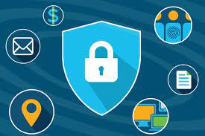
Cybersecurity: Definition and Scope
Cybersecurity, at its core, is the intricate dance between safeguarding digital systems and navigating the complex web of cyber threats that loom in the digital landscape.
In the digital age where our lives are intricately woven into the fabric of the online world, cybersecurity becomes a paramount concern.
The scope of cybersecurity is not confined to individual users but permeates through organizations and critical infrastructures.

Slide 4
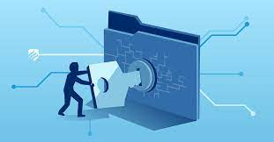
Various Types of Cybersecurity Threats
In the intricate realm of cybersecurity, understanding the diverse spectrum of threats is paramount.
One prominent category is malware that encompass malicious software like viruses and trojans designed to infiltrate and disrupt systems.
Phishing relies on deceptive tactics to trick individuals into divulging sensitive information.
Ransomware encrypts data and demands payment for its release. Meanwhile, Distributed Denial of Service (DDoS) attacks overwhelm networks that render them inaccessible.

Slide 5
Security Requirements for Cybersecurity
Cybersecurity is a proactive strategy that requires a comprehensive understanding of potential vulnerabilities and the implementation of stringent security requirements.
To construct a formidable defense, organizations must adopt a multi-faceted approach. This involves not only investing in modern technologies but also fostering a cybersecurity aware culture.
Regular training and awareness programs are essential to equip employees with the knowledge and skills needed to identify and thwart potential threats.
Encryption stands as a cornerstone in the arsenal of security requirements, ensuring that sensitive data remains unintelligible to unauthorized entities.

Slide 6
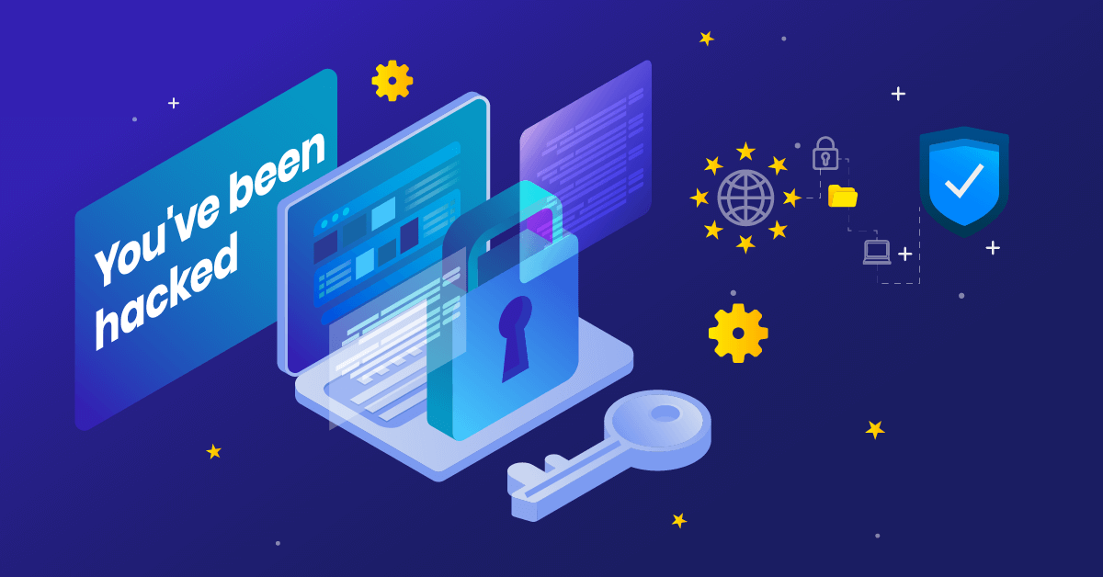
Recent Cyber Attacks
Recent cyber attacks have not only disrupted digital landscapes but have also sent shockwaves across the globe that expose vulnerabilities in our interconnected world.
One such shocking reality unfolded when a major multinational corporation fell victim to a sophisticated ransomware attack that cripple its operations and causing widespread panic.
The attackers exploited weaknesses in the organization's digital infrastructure that highlighting the pressing need for fortified cyber defenses. The audacity and scale of these attacks underscore evolving nature of cyber threats and necessity for constant vigilance.

Slide 7
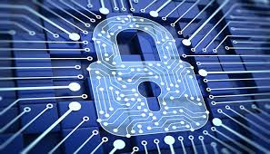
A Guide to Cybersecurity Discourse
Effective communication is paramount and it serves as a guiding beacon that illuminating the intricate web of concepts and challenges within this dynamic field.
The goal is not merely to disseminate information but to empower the audience with a nuanced understanding of cybersecurity's multifaceted landscape.
From phishing attacks to ransomware, outlining these threats helps the audience comprehend the diverse tactics employed by cyber adversaries.

Slide 8
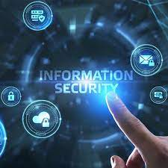
Chosen Cyber Attack
In the ever-evolving landscape of cyber threats, it is imperative to unravel the complexities of specific cyber attacks to comprehend their intricacies and devise effective countermeasures.
The selected cyber attack stands as a testament to the sophistication and audacity of modern cyber threats.
Cyber attacks often exploit vulnerabilities in software, networks, or human behavior. Whether it be a ransomware assault crippling critical infrastructure or a stealthy data breach compromising sensitive information, each incident carries its unique signature.

Slide 9
Results from Described Cyber Attack
In the realm of cybersecurity, the aftermath of a cyber attack reveals a tapestry of consequences that extends far beyond the immediate breach.
One of the primary outcomes is the compromise of sensitive data. Cyber attacks have the potential to expose a treasure trove of confidential details. This not only jeopardizes the privacy of individuals but also poses a significant threat to national security and corporate integrity.
Financial ramifications loom large in the aftermath with the cost of a cyber attack extending well beyond the immediate response.

Slide 10
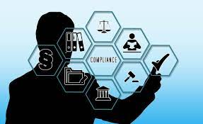
Lessons from the Cyber Battlefield
In the ever evolving landscape of cyber threats, the battlefield is dynamic, requiring continuous adaptation and strategic foresight.
Lessons from the cyber battlefield serve as crucial waypoints in crafting effective defense mechanisms and ensuring the resilience of our digital ecosystems.
One fundamental lesson centers around the interconnectedness of individuals and nations in the cyber realm. Cybersecurity is not solely an individual responsibility as it is a collective effort.

Slide 11
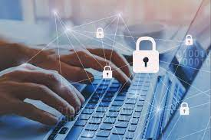
Human Element: How Individuals Can Bolster Cybersecurity
Individuals play a pivotal role in bolstering cybersecurity measures, as their actions can either fortify or compromise the digital realm.
The advent of the internet and the proliferation of digital technologies have interconnected the world that provide unprecedented opportunities for communication and innovation.
One fundamental aspect of enhancing cybersecurity is promoting awareness and education.
Cybersecurity awareness campaigns can educate users about the importance of strong, unique passwords and the significance of regularly updating software and operating systems.

Slide 12
Safeguarding Critical Infrastructure
Critical infrastructure that include power plants and financial systems forms the backbone of modern society.
Protecting these vital assets from cyber threats is a collective responsibility that involves collaboration between government agencies and individuals.
Government bodies must enact robust regulations and standards to ensure the cybersecurity of critical infrastructure.
Regular audits and assessments can identify vulnerabilities, and incentivizing private sector cooperation through tax benefits or other mechanisms can encourage the implementation of cybersecurity measures.

Slide 13
Cyber Hygiene: Best Practices
Cyber hygiene refers to the practices and habits individuals adopt to maintain a secure digital existence.
Just as personal hygiene is crucial for physical well-being, cyber hygiene is essential for protecting oneself from the myriad of online threats.
One of the foundational aspects of cyber hygiene is the creation and maintenance of strong, unique passwords.
Passwords serve as the first line of defense against unauthorized access to personal accounts and sensitive information.

Slide 14
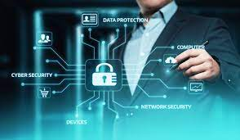
Power of Information Sharing in Cybersecurity
The sharing of threat intelligence is a cornerstone of collaborative defense. By exchanging information about emerging threats and vulnerabilities, organizations can proactively strengthen their defenses.
Public-private partnerships are instrumental in fostering information sharing.
Government agencies and private sector organizations can collaborate to create platforms and initiatives that facilitate the exchange of cybersecurity intelligence.

Slide 15
Emerging Technologies in Cybersecurity Arsenal
As cyber threats become more sophisticated, the arsenal of cybersecurity measures must evolve in tandem.
Beyond the basics of firewalls and encryption that emerge technologies are playing a crucial role in fortifying digital defenses.
Artificial Intelligence (AI) and machine learning are at the forefront of this technological evolution.
These technologies empower cybersecurity systems to analyze vast amounts of data and detect anomalies in real-time.

Slide 16
Future Frontiers
As we step into the future, the digital age presents unprecedented challenges and opportunities in the realm of cybersecurity.
One of the future frontiers in cybersecurity is the integration of cybersecurity into the fabric of emerging technologies.
As artificial intelligence, quantum computing and IoT continue to advance that embed robust cybersecurity measures from the outset becomes imperative.
This proactive approach can mitigate potential vulnerabilities before they are exploited by malicious actors.
International collaboration is essential in addressing global cyber threats.

Slide 17
Reference
Deb, R., & Roy, S. (2022). A comprehensive survey of vulnerability and information security in SDN. Computer Networks, 206, 108802.
Reshmi, T. R. (2021). Information security breaches due to ransomware attacks-a systematic literature review. International Journal of Information Management Data Insights, 1(2), 100013.
Wiley, A., McCormac, A., & Calic, D. (2020). More than the individual: Examining the relationship between culture and Information Security Awareness. Computers & security, 88, 101640.
Ma, X. (2022). IS professionals’ information security behaviors in Chinese IT organizations for information security protection. Information Processing & Management, 59(1), 102744.
Cram, W. A., Proudfoot, J. G., & D'Arcy, J. (2021). When enough is enough: Investigating the antecedents and consequences of information security fatigue. Information Systems Journal, 31(4), 521-549.

